Slide 1
NCHRP 25-25, Task 120
Use of the State Department of Transportation Portal to the International Stormwater BMP Database
Project Background and DOT Portal Tutorial
March 2020

Slide 2
Outline
Project Objective
Background on the International Stormwater BMP Database
Introduction to the DOT Portal
Using the DOT Portal
  Retrieve BMP Data using the Map
  Retrieve BMP Data using the Data Query & Statistical Analysis Tool
Data Inventory and Summary Report
Data Gaps and Needs
Summary and Conclusions

Slide 3

Project Objective
Provide streamlined access to BMP study data and performance statistics that are most relevant to state DOTs to support regulatory discussions, stormwater management guidance, and planning and designing stormwater control measures that meet regulatory requirements and level of service goals
This Photo by Unknown Author is licensed under CC BY-SA

Slide 4





Background of International Stormwater BMP Database
Brief history of this long-term project
What is the BMP Database?
What kinds of BMP study site data, BMP design information and observed performance data does it contain?
What are the options for accessing these data sets as well as BMP performance summary statistics?

Slide 5
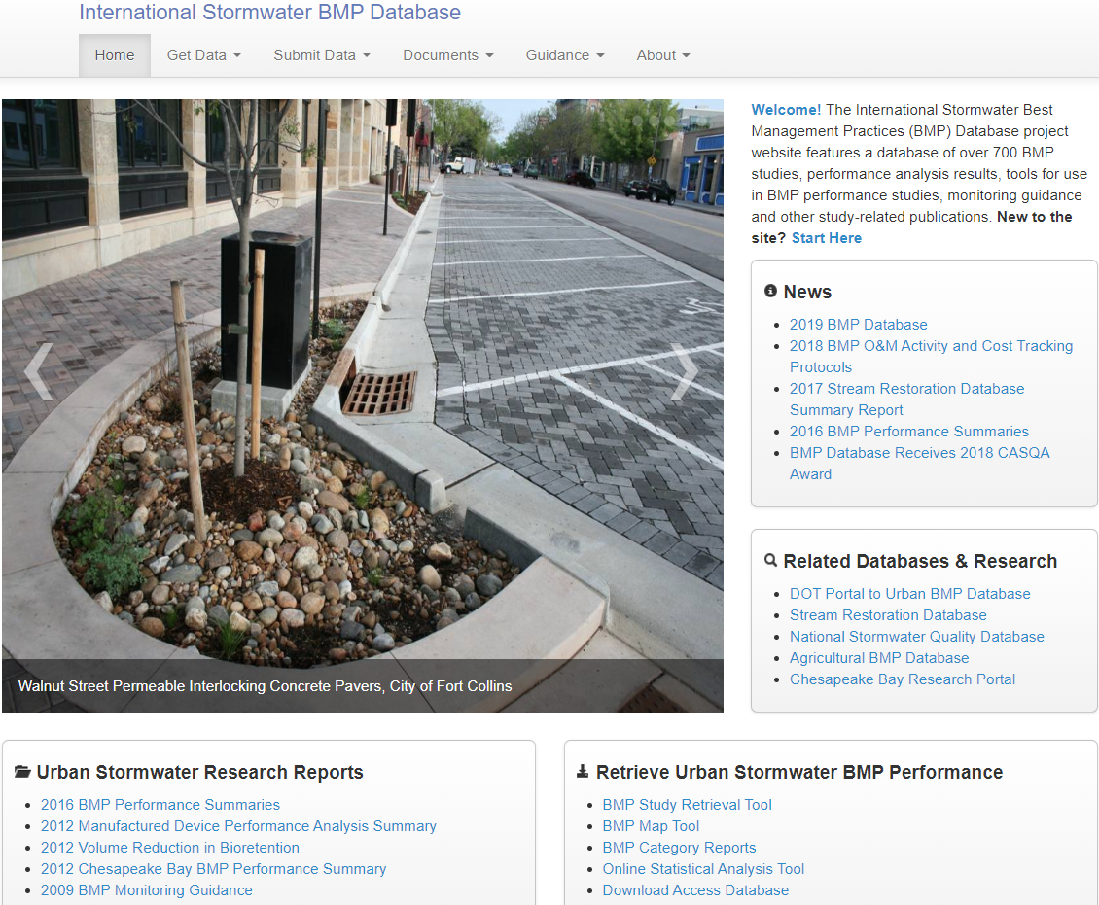

www.bmpdatabase.org

Slide 6
BMP Database “Org” Chart
Clean Water Act Goals
Fishable & Swimmable
Agricultural
BMPs
Urban Stormwater BMPs
(Structural, GI/LID, Source Controls)
Stream Restoration
Urban Stormwater Runoff Characterization (NSQD)
DOT
Portal

Slide 7
>25 Years of Collaboration
Key Dates in the BMP Database
1994: Birth of an idea
1996-2002: EPA and ASCE build and grow the tool
2004: WERF (Jeff Moeller) takes the lead of sponsor coalition that includes ASCE-EWRI, FHWA & others
2004-2018: Coalition invests in expanding data sets and improving the database and access
…but none of it would be possible without researchers who share data.
Notes:
1994-1996: Genesis of project—Engineering Foundation Conference & Support from Mike Cook, EPA
1996-2002: EPA provides funding via ASCE for Urban BMP Database
Original ASCE Manager: Tom McLane
Original Principal Investigators: B. Urbonas, J. Jones, E. Strecker
Reporting protocols, initial database on CD, monitoring guidance
UWRRC Advisory Panel (Bicknell, Clar, Field, Heaney, Herricks, Huber, Roesner, Yu) & Many Reviewers/Beta Testers
~2003: Project Team maintains project during transition while pursuing funding/partners
2004: Urban BMP Database:
WE&RF agrees to lead database project and form a coalition of sponsors (WE&RF: Jeff Moeller, Theresa Connor, Harry Zhang)
Sponsor Coalition includes FHWA, EWRI, EPA (special projects only), APWA (some years); primary funders are WE&RF & FHWA (>90%)
www.bmpdatabase.org became distribution mechanism for all products
2008-2009: Expert Panel convened to expand into LID/GI; UWRRC representation: Traver, Hunt, Pitt, Urbonas, Roseen, Horner
2009: EPA & WE&RF fund Urban Stormwater BMP Monitoring Guidance (updated to include LID/GI)
Mini-grants Program: Small grants to researchers to compensate time needed to enter data (1999 and ~2008)
2012: Began expanding into companion projects (Agriculture, Stream Restoration)
2017-2019: Expanding cost data set and transportation-related tools

Slide 8
What is the Urban Stormwater BMP Database?
Information from a large collection of BMP performance studies containing metadata on site conditions and design parameters and stormwater monitoring results (water quality, precip., flow)
Researchers, MS4s, DOTs, and others voluntarily submit data to a clearinghouse for screening and upload to the master database
Process: Enter data in standardized Excel spreadsheets, submit to Clearinghouse for data review and upload
Data and project findings are made publicly available through www.bmpdatabase.org
Much more than % Removal. Includes:
Test Site/Location
Watershed/Land Use
BMP Design & Maintenance
Monitoring Methods
Event-Based Data: Precip, Flow, WQ
Construction and O&M Costs

Slide 9
Relational Structure of Urban BMP Database
Test Site
(location, study sponsors, documents)
Watershed(s)
(drainage characteristics, land use, roads)
Monitoring Stations
Monitoring Events
Monitoring Costs
General BMP Information
Monitoring Data
(precip., flow, water quality)
BMP Design Data
(for specific BMP types)
BMP Cost Data
Notes:
As part of the DOT portal development, additional DOT parameters were added to the watershed table and the BMP Design and Monitoring/Instrumentation tables were simplified. It is now much easier to create queries based on these changes.

Slide 10
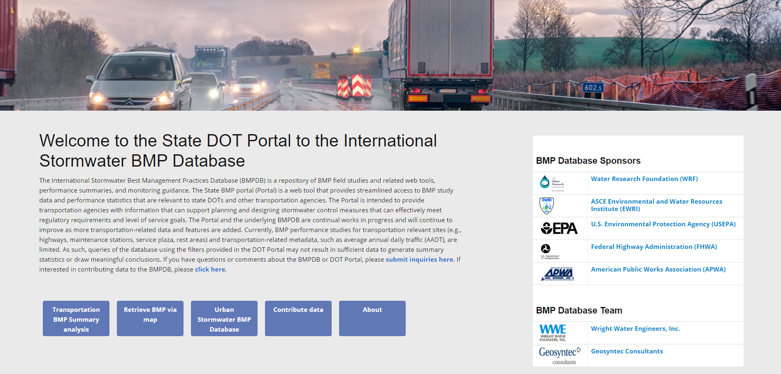
DOT Portal to the BMP Database https://dot.bmpdatabase.org

Slide 11
DOT-Specific features of the Portal
Provides streamlined access to BMP data relevant to DOTs
Statistical analysis tool allow users to filter for DOT-related activities
Data downloads include DOT-related data fields such as AADT number of lanes
Can serve as a data clearinghouse for DOTs conducting BMP research

Slide 12
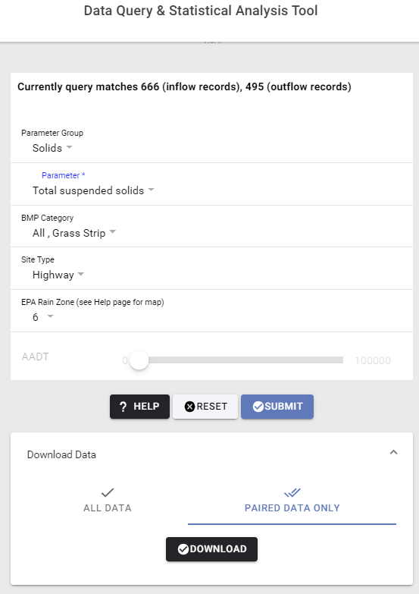
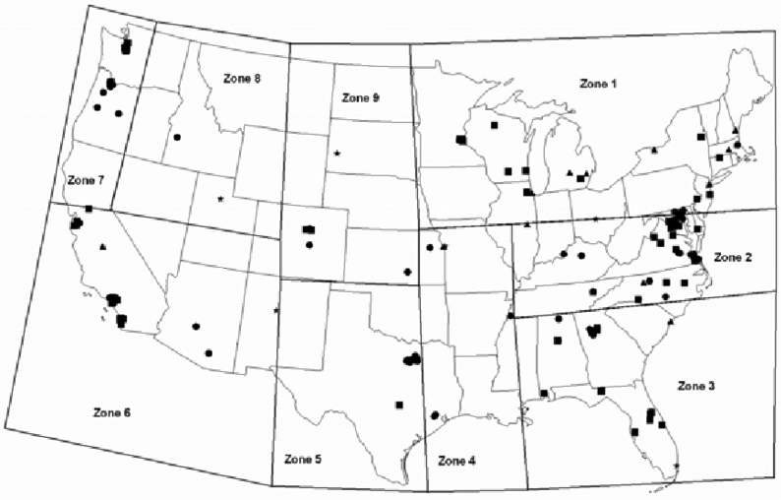
Using the Analysis Tool – Simple Data Query
Available Query Fields
  Parameter Group (required)
  Parameter (required)
  BMP Category (type)
  Site Type (DOT-related land use activity)
  EPA Rain Zones
  AADT Ranges (currently disabled)
After above field selections made
  Select Submit button to get statistics
  Download All Data
  Download Paired Data Only (influent/effluent data pairs only)
Notes:
A simple data query includes selecting from the query field drop down menus starting with a water quality parameter group and parameter.
The other fields are optional and the tool updates to display the number of inflow and outflow records that are available following each field selection.
EPA rain zones can be used to group studies based on general climate conditions. This geographic grouping was selected instead of state boundaries because many states have more than one climate region. Also, there are currently several states without any BMP data.
Average Annual Daily Traffic (AADT) selections are currently disabled due to limited data currently available for the applicable highway sites. This feature will be enabled in the future after additional AADT site data are added to the BMP Database.
Downloaded data will include AADT data if available

Slide 13
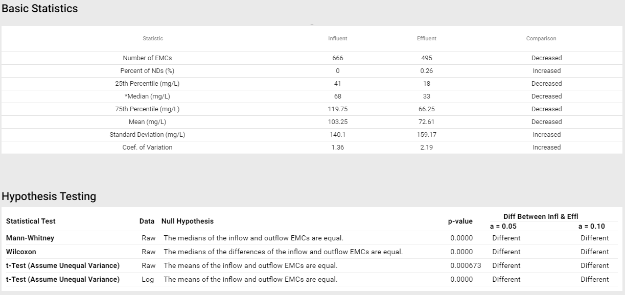
Using the Analysis Tool – Generating Statistics
Query Parameters: TSS, Grass Strips, Highways, EPA Rain Zone 6
Notes:
Various summary statistics of influent and effluent concentrations are produced and compared by the tool.
Number of EMCs – is the total number of storm event mean concentrations (EMCs)
Percent of NDs – is the percentage of the total number of storm event samples that were below detection limits
Hypothesis testing is used to evaluate whether the influent and effluent concentrations are statistically different from each other.
Mann-Whitney rank sum test: evaluates whether the medians of the inflow and outflow EMCs are equal. This test assumes the inflow and outflow EMCs are independent.
Wilcoxon signed rank test: evaluates whether the median of the differences of the inflow and outflow EMCs is greater than zero. This test assumes the inflow and outflow EMCs are dependent (paired).
t-Test: evaluates whether the means of the inflow and outflow EMCs are equal. This test assumes that the inflow and outflow EMCs are normally distributed. This test is run on the raw data and log-transformed data.
If the p-value resulting from a test is less than the selected alpha (a) significance value, then the null hypothesis the data sets are equal is rejected.

Slide 14
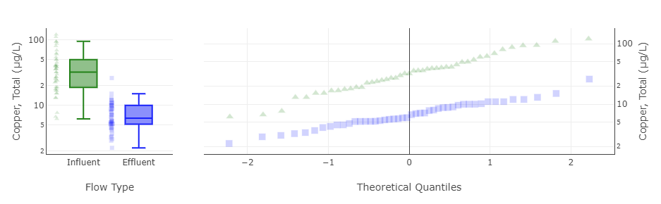
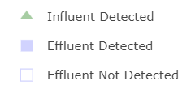
Using the Analysis Tool – Interactive Plots
Influent/Effluent Box Plots
Influent/Effluent Probability Plots
Query Parameters: Total Copper, Bioretention, Highways, All Rain Zones
Notes:
All of the data plots in the tool are interactive. Users can hover over the data points to identify their values and can zoom and pan on the plots.
Influent/Effluent box plots and probability plots provide a visual summary of the influent and effluent data distributions. Both show the data plotted on a log scale.
The box plots show the central tendencies, interquartile ranges (25th and 75th percentiles), upper and lower fences (1.5xIQR away from upper and lower quartiles), and identify potential outlier values. The dot plots next to each boxplot shows the full range of data.
The probability plots include independently ranked influent and effluent data plotted on a normal probability scale (theoretical quantiles = Z score). Because the y-axis is log scale, if the data plot on a straight line on the probability plot, the data may be lognormally distributed. It is important to note that the influent and effluent values are not paired by storm event in these plots.

Slide 15
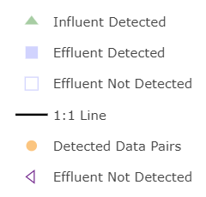
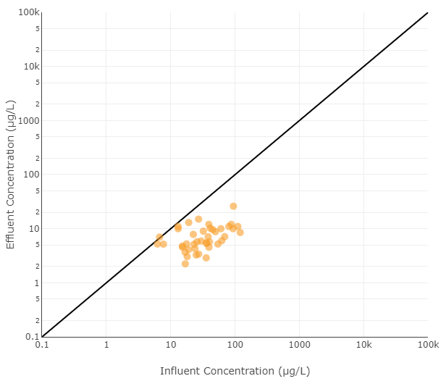
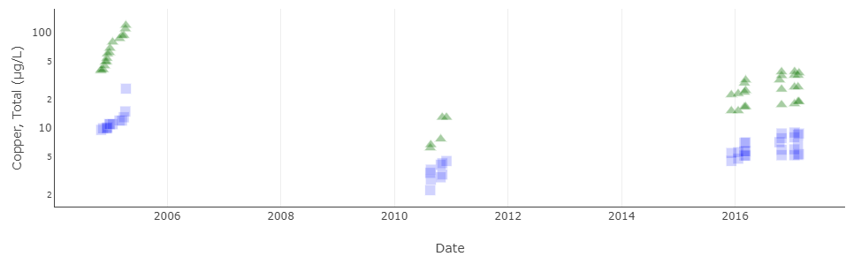
Using the Analysis Tool – Interactive Plots (cont.)
Influent/Effluent Time Series Plots
Influent/Effluent Scatter Plot with 1:1 Line
Query Parameters: Total Copper, Bioretention, Highways, All Rain Zones
Notes:
The next two plots include influent and effluent data paired by storm event.
The influent effluent scatter plot provides an indication of potential dependency of the effluent concentrations on the influent concentrations. The example above indicates only a slight relationship between the influent and effluent total copper concentrations for bioretention at highway sites.
The time series plots provide a quick summary of the time periods of the underlying data sets and whether there are any temporal trends that may be worth further analysis.

Slide 16
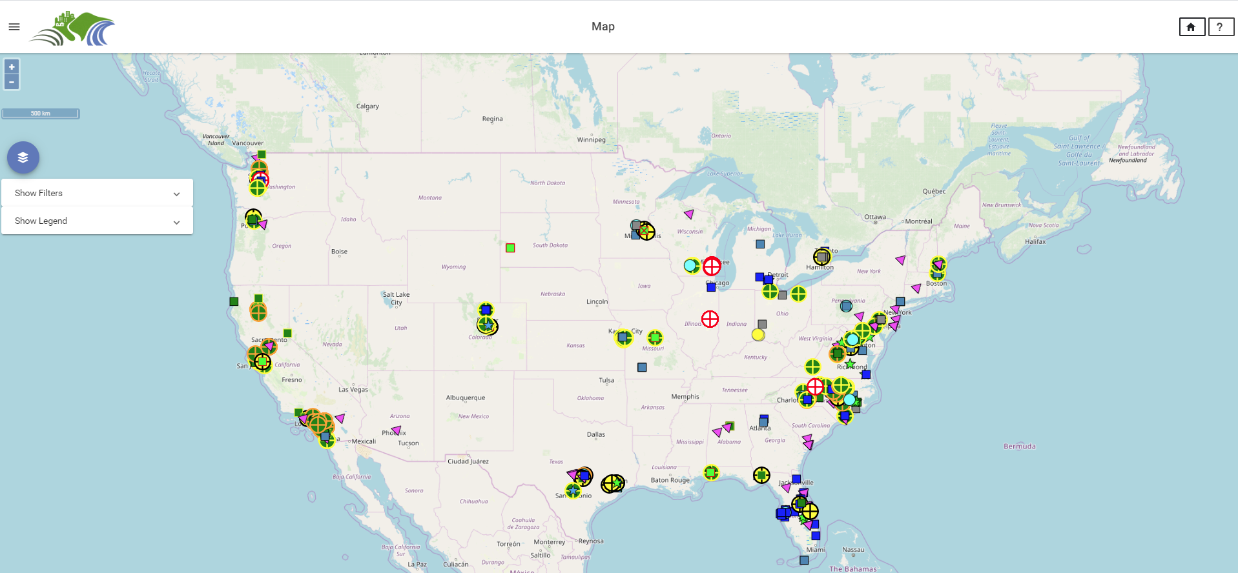
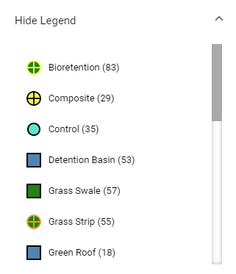
Using the Map – Basic Features and Navigation
Navigate Menu
Return to Home
Zoom Controls
(ctrl scroll also works)
About
Toggle Data Layers
Show Data Filters and Legend
Notes:
The Map includes standard pan and zoom functionality and simple navigation.

Slide 17
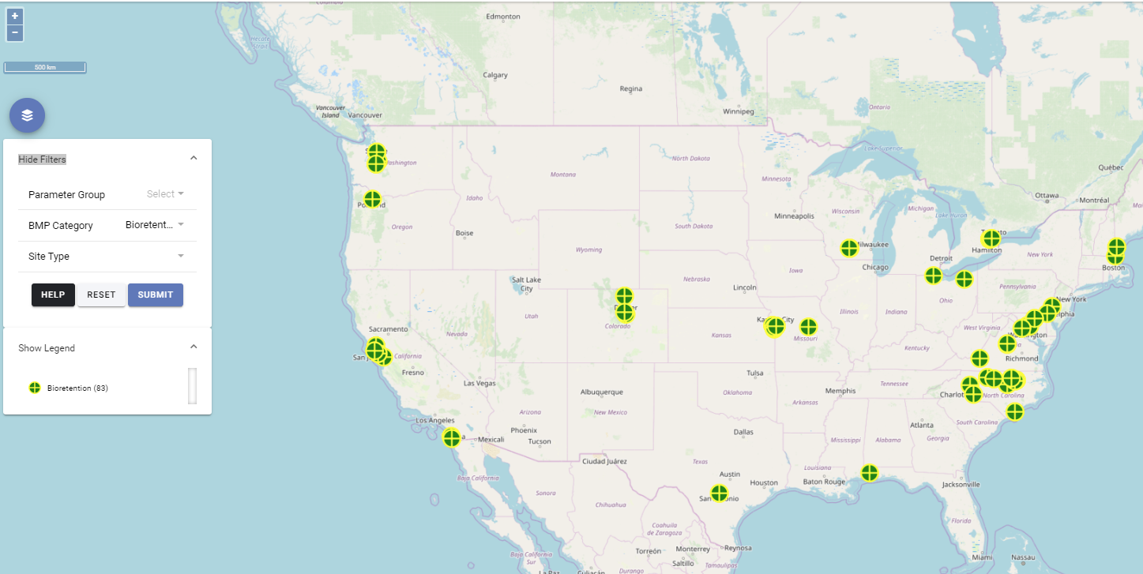
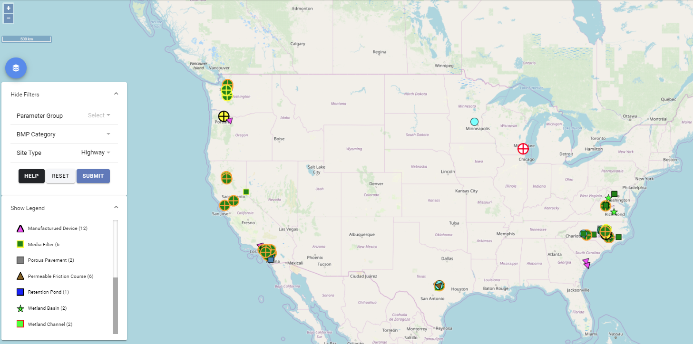
Using the Map – Data Filtering
Select Show Filters
Apply Desired Filters
  Parameter Group
  Parameter
  BMP Category
  Site Type
Select Submit to update Map
  Wait a few seconds for query to complete
  Message box will indicate number of BMP sites that were successfully retrieved
Zoom/pan to a geographic region of the map
Map of All Bioretention BMP Sites
Map of All Highway BMP Sites

Slide 18
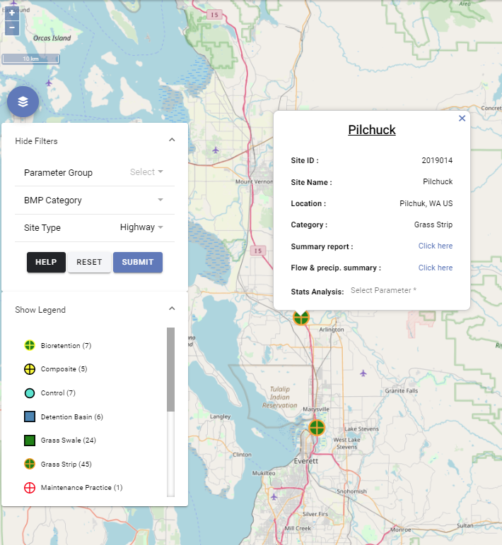
Using the Map – Selecting / Analyzing a Single Site
Click a BMP Site
Site ID, Site Name, Location, and BMP Category will display
Links for summary report and flow & precipitation report display
Water quality data can be explored and retrieved by selecting a parameter group and parameter
Selected Grass Strip Site in Pilchuck, WA

Slide 19
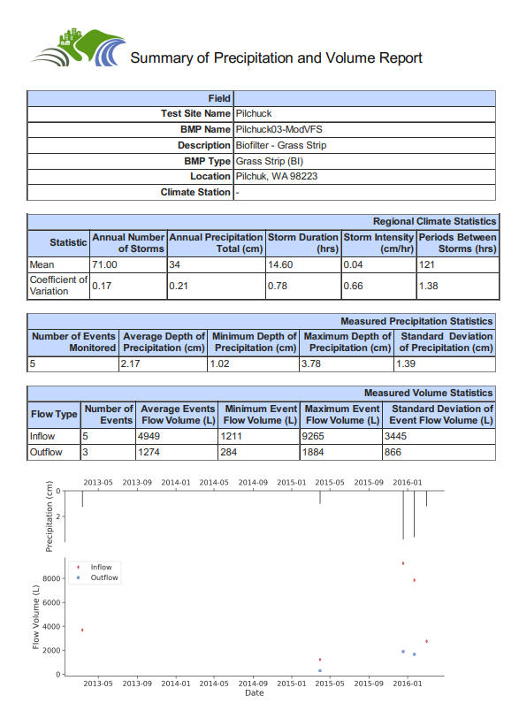
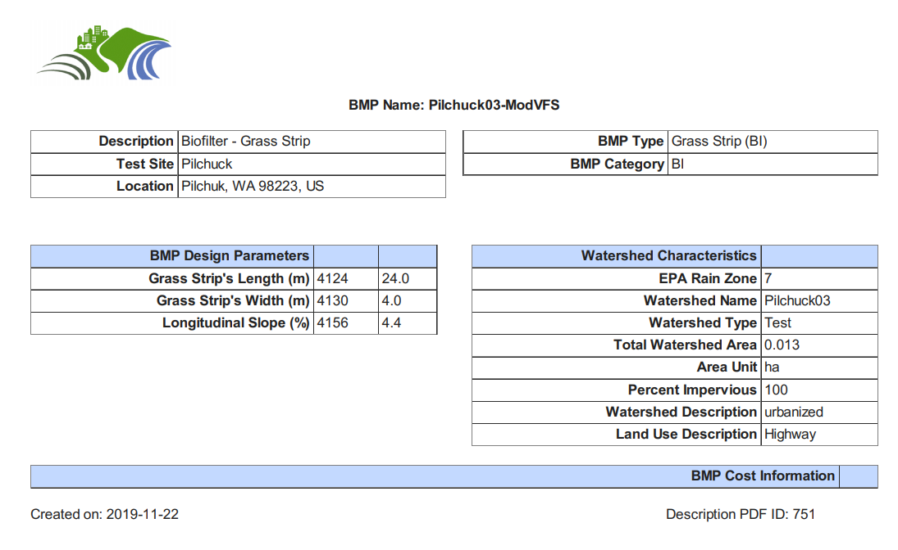
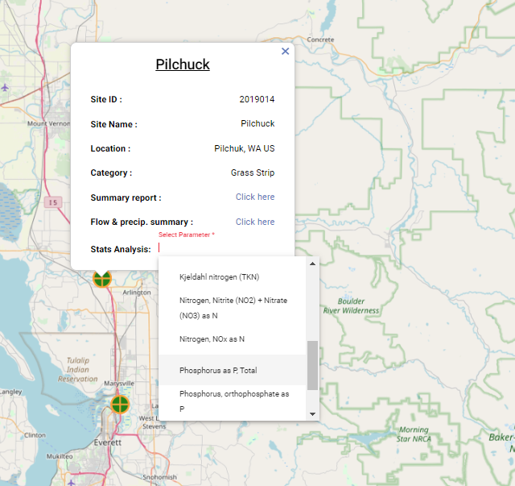
Using the Map – Selecting / Exploring a Site (cont.)
Notes:
After clicking a site, there are two PDF reports that can be accessed.
The first is a site summary report that provides major design parameters and watershed characteristics.
The second is a flow and precipitation summary that provides regional storm event statistics, measured precipitation and runoff volumes, and plots of monitored storms.
Water quality data for the site can be accessed by selecting an available parameter from the Stat Analysis dropdown menu. Clicking a parameter launches the Data Query and Statistical Analysis Tool. If adequate data are available for analysis, summary statistics and data plots will be generated for the Site and selected parameter. If limited data are available, the data can still be downloaded and independently analyzed.

Slide 20
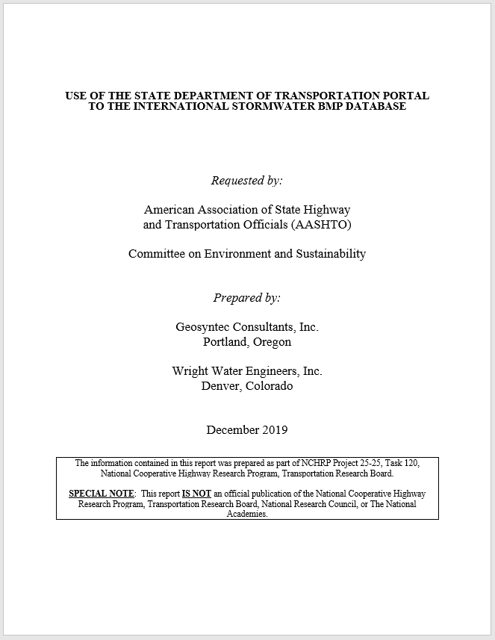
Data Analysis Report
Provides an inventory of BMP studies in the BMPDB including DOT-related studies
Includes a statistical summary of influent and effluent data by BMP category
Identifies data gaps and needs for expanding the BMPDB and conducting future analyses
Notes:
This presentation includes some of the statistical summaries for a subset of the constituents included in the main report.

Slide 21
Constituents and BMPs Analyzed
Constituent Group | Constituent
Solids | Total suspended solids (TSS)
 | Total dissolved solids (TDS)
Bacteria | Fecal coliform
 | Escherichia coli (E. coli)
 | Enterococcus
Metals | Arsenic (total and dissolved)
 | Cadmium (total and dissolved)
 | Chromium (total and dissolved)
 | Copper (total and dissolved)
 | Iron (total and dissolved)
 | Lead (total and dissolved)
 | Nickel (total and dissolved)
 | Zinc (total and dissolved)
Nutrients | Total phosphorus
 | Orthophosphate
 | Dissolved phosphorus
 | Total nitrogen
 | Total Kjeldahl nitrogen (TKN)
 | Nitrate (NO₃)
 | Nitrate plus nitrite (NO₃ + NO₂)
 | Nitrate and Nitrate plus nitrite (NOx)
BMP Category | Code
Detention Basin | DB
Retention Pond | RP
Wetland Basin | WB
Wetland Channel | WC
Grass Swale | BS
Grass Strip | BI
Bioretention | BR
Media Filter | MF
High Rate Biofiltration | HRBF
High Rate Media Filtration | HRMF
Hydrodynamic Separation Devices | HDS
Oil/Grit Separators and Baffle Boxes | OGS
Permeable Friction Course | PF
Porous Pavement | PP
Notes:
Constituents and BMPs were selected for analysis due to their potential relevance and applicability to DOTs as well as the quantity of study data available in the BMPDB.

Slide 22
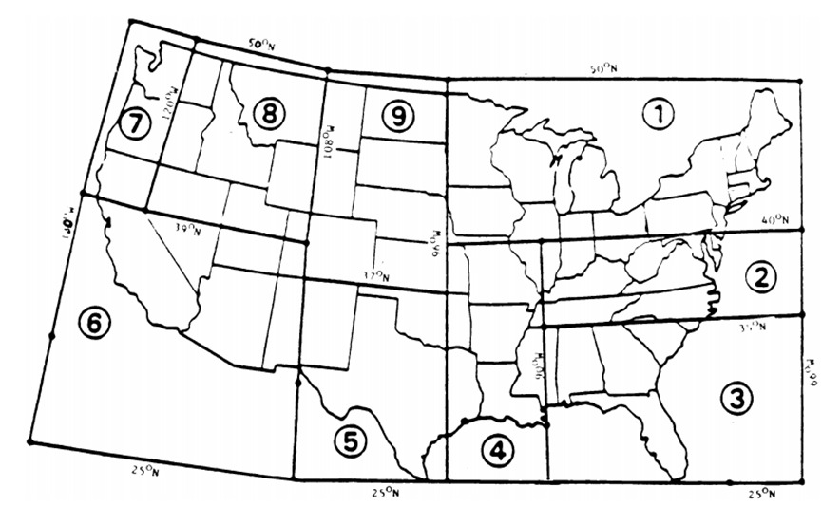
Data Inventory – Studies by Rain Zone
EPA Rain Zone | DOT | Non-DOT | Unspecified | All Sites
1 | 28 | 50 | 1 | 79
2 | 80 | 52 | 6 | 138
3 | 21 | 58 | 9 | 88
4 | 10 | 14 | 0 | 24
5 | 19 | 23 | 3 | 45
6 | 58 | 10 | 28 | 96
7 | 39 | 30 | 0 | 69
8 | 0 | 0 | 0 | 0
9 | 18 | 15 | 0 | 33
Unknown | 4 | 6 | 0 | 10
Total | 277 | 258 | 47 | 582
DOT Studies are those with primary land uses of urban roadway, highway, parking facility, service plaza, or maintenance station
EPA Rain Zone Map
Source: NPDES Phase I regulations, 40 CFR Part 122, Appendix E (USEPA 1990)

Slide 23
Data Inventory – Studies by State
DOT Studies are those with primary land uses of urban roadway, highway, parking facility, service plaza, or maintenance station
ZZ – Outside of the United States
Notes:
DOTs with the most studies in the database include Caltrans, North Carolina, Virginia, Texas and Washington. One of the reasons that Caltrans has so many studies is that a batch upload of the Caltrans database was possible. In Washington, many of the manufactured device studies for TAPE are in highway settings.

Slide 24
Inventory by BMP Category and DOT Site Type
DOT Site Type BMP Category | Urban Roadway | Highway | Parking Facility | Service Plaza | Maintenance Station | Un-specified | Non-DOT | All Sites
Detention Basin (DB) | 1 | 6 | 7 | 0 | 0 | 2 | 37 | 53
Retention Pond (RP) | 6 | 1 | 2 | 0 | 1 | 4 | 73 | 87
Wetland Basin (WB) | 4 | 2 | 1 | 0 | 1 | 3 | 33 | 44
Wetland Channel (WC) | 3 | 2 | 0 | 0 | 0 | 1 | 17 | 23
Grass Swale (GS) | 2 | 24 | 7 | 0 | 1 | 13 | 10 | 57
Grass Strip (GI) | 0 | 45 | 2 | 0 | 2 | 3 | 3 | 55
Bioretention (BR) | 7 | 7 | 31 | 1 | 2 | 10 | 25 | 83
Media Filter (MF) | 2 | 6 | 7 | 1 | 4 | 8 | 22 | 50
High Rate Biofiltration (HRBF) | 1 | 1 | 3 | 0 | 0 | 0 | 1 | 6
High Rate Media Filtration (HRMF) | 4 | 4 | 7 | 1 | 1 | 0 | 6 | 23
Hydrodynamic Separation Devices (HDS) | 1 | 6 | 4 | 0 | 2 | 1 | 16 | 30
Oil/Grit Separators and Baffle Boxes (OGS) | 2 | 1 | 3 | 0 | 3 | 1 | 9 | 19
Permeable Friction Course (PF) | 0 | 6 | 0 | 0 | 0 | 0 | 0 | 6
Porous Pavement (PF) | 4 | 2 | 33 | 0 | 0 | 1 | 6 | 46
Total | 37 | 113 | 107 | 3 | 17 | 47 | 258 | 582
Manufactured Devices
Notes:
The manufactured device changes to the database are new and are based on input from an advisory panel as part of the 2019-2020 BMP Database project effort. For the past several years, manufactured device statistics have not been generated. Now that there are new subcategories that have been vetted among a diverse group of proprietary device vendors and manufacturers, performance summaries from manufactured devices can now be produced for certain subcategories.
This slide shows the overall inventory of BMP types. For summary statistics presented later, a subset of these practices was included in the analysis. For examples, infiltration basins, MCTTs, and Volume Capture MTDs were excluded due to relatively low numbers of studies, as well as other factors. Catch basin inserts were excluded due to the need for additional analysis to further subcategorize gross solids type devices from others that may provide more filtration.

Slide 25
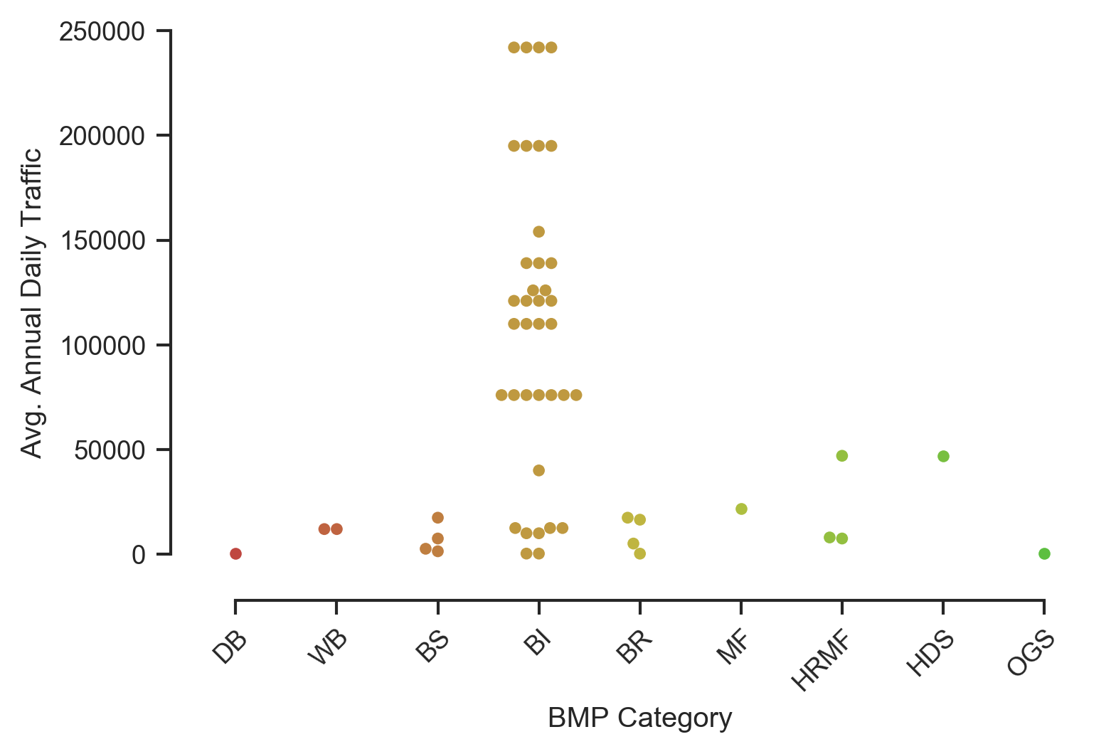
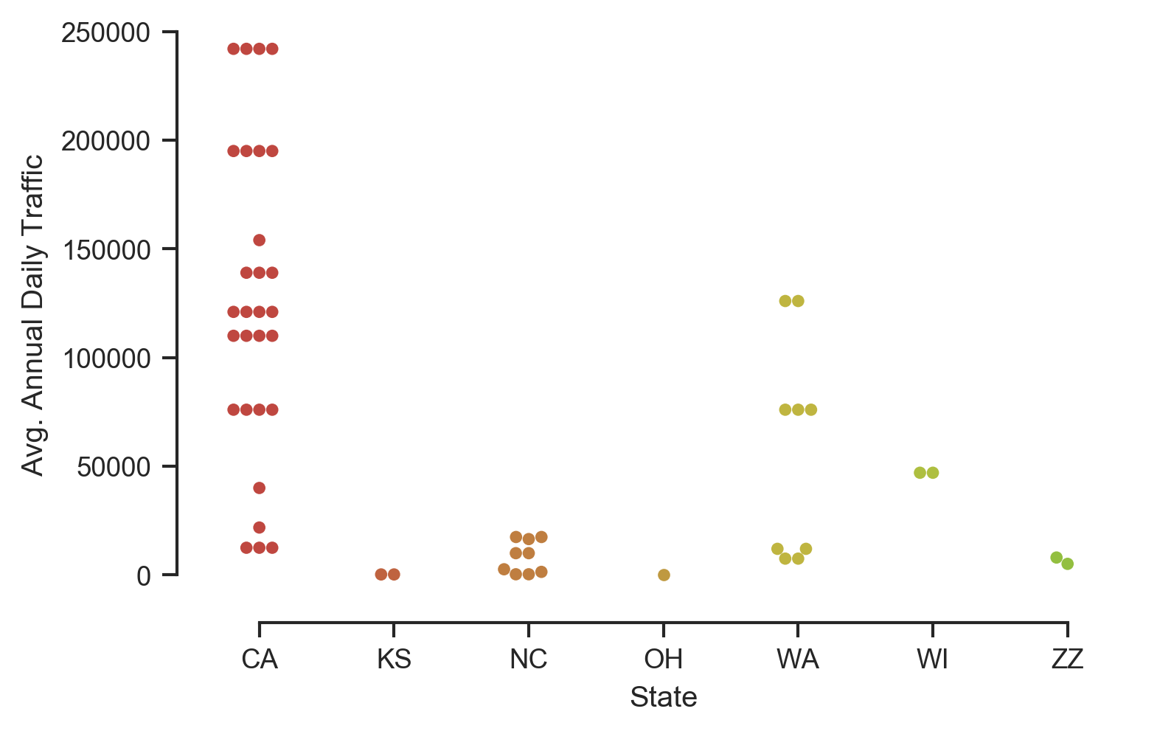
Data Inventory by Average Annual Daily Traffic
AADT vs BMP Category
AADT by State (ZZ = non-US)
DB – detention basin WB – wetland basin WC – wetland channel BS – grass swale | BI – grass strip BR – bioretention MF – media filter HRBF – high rate biofilter | HRMF – high rate media filter HDS – hydrodynamic separator OGS – oil/grit separators
Notes:
This only shows urban roadway and highway DOT sites (i.e., those that could be expected to have AADT data)
Each dot on the swarmplot is an individual study.

Slide 26
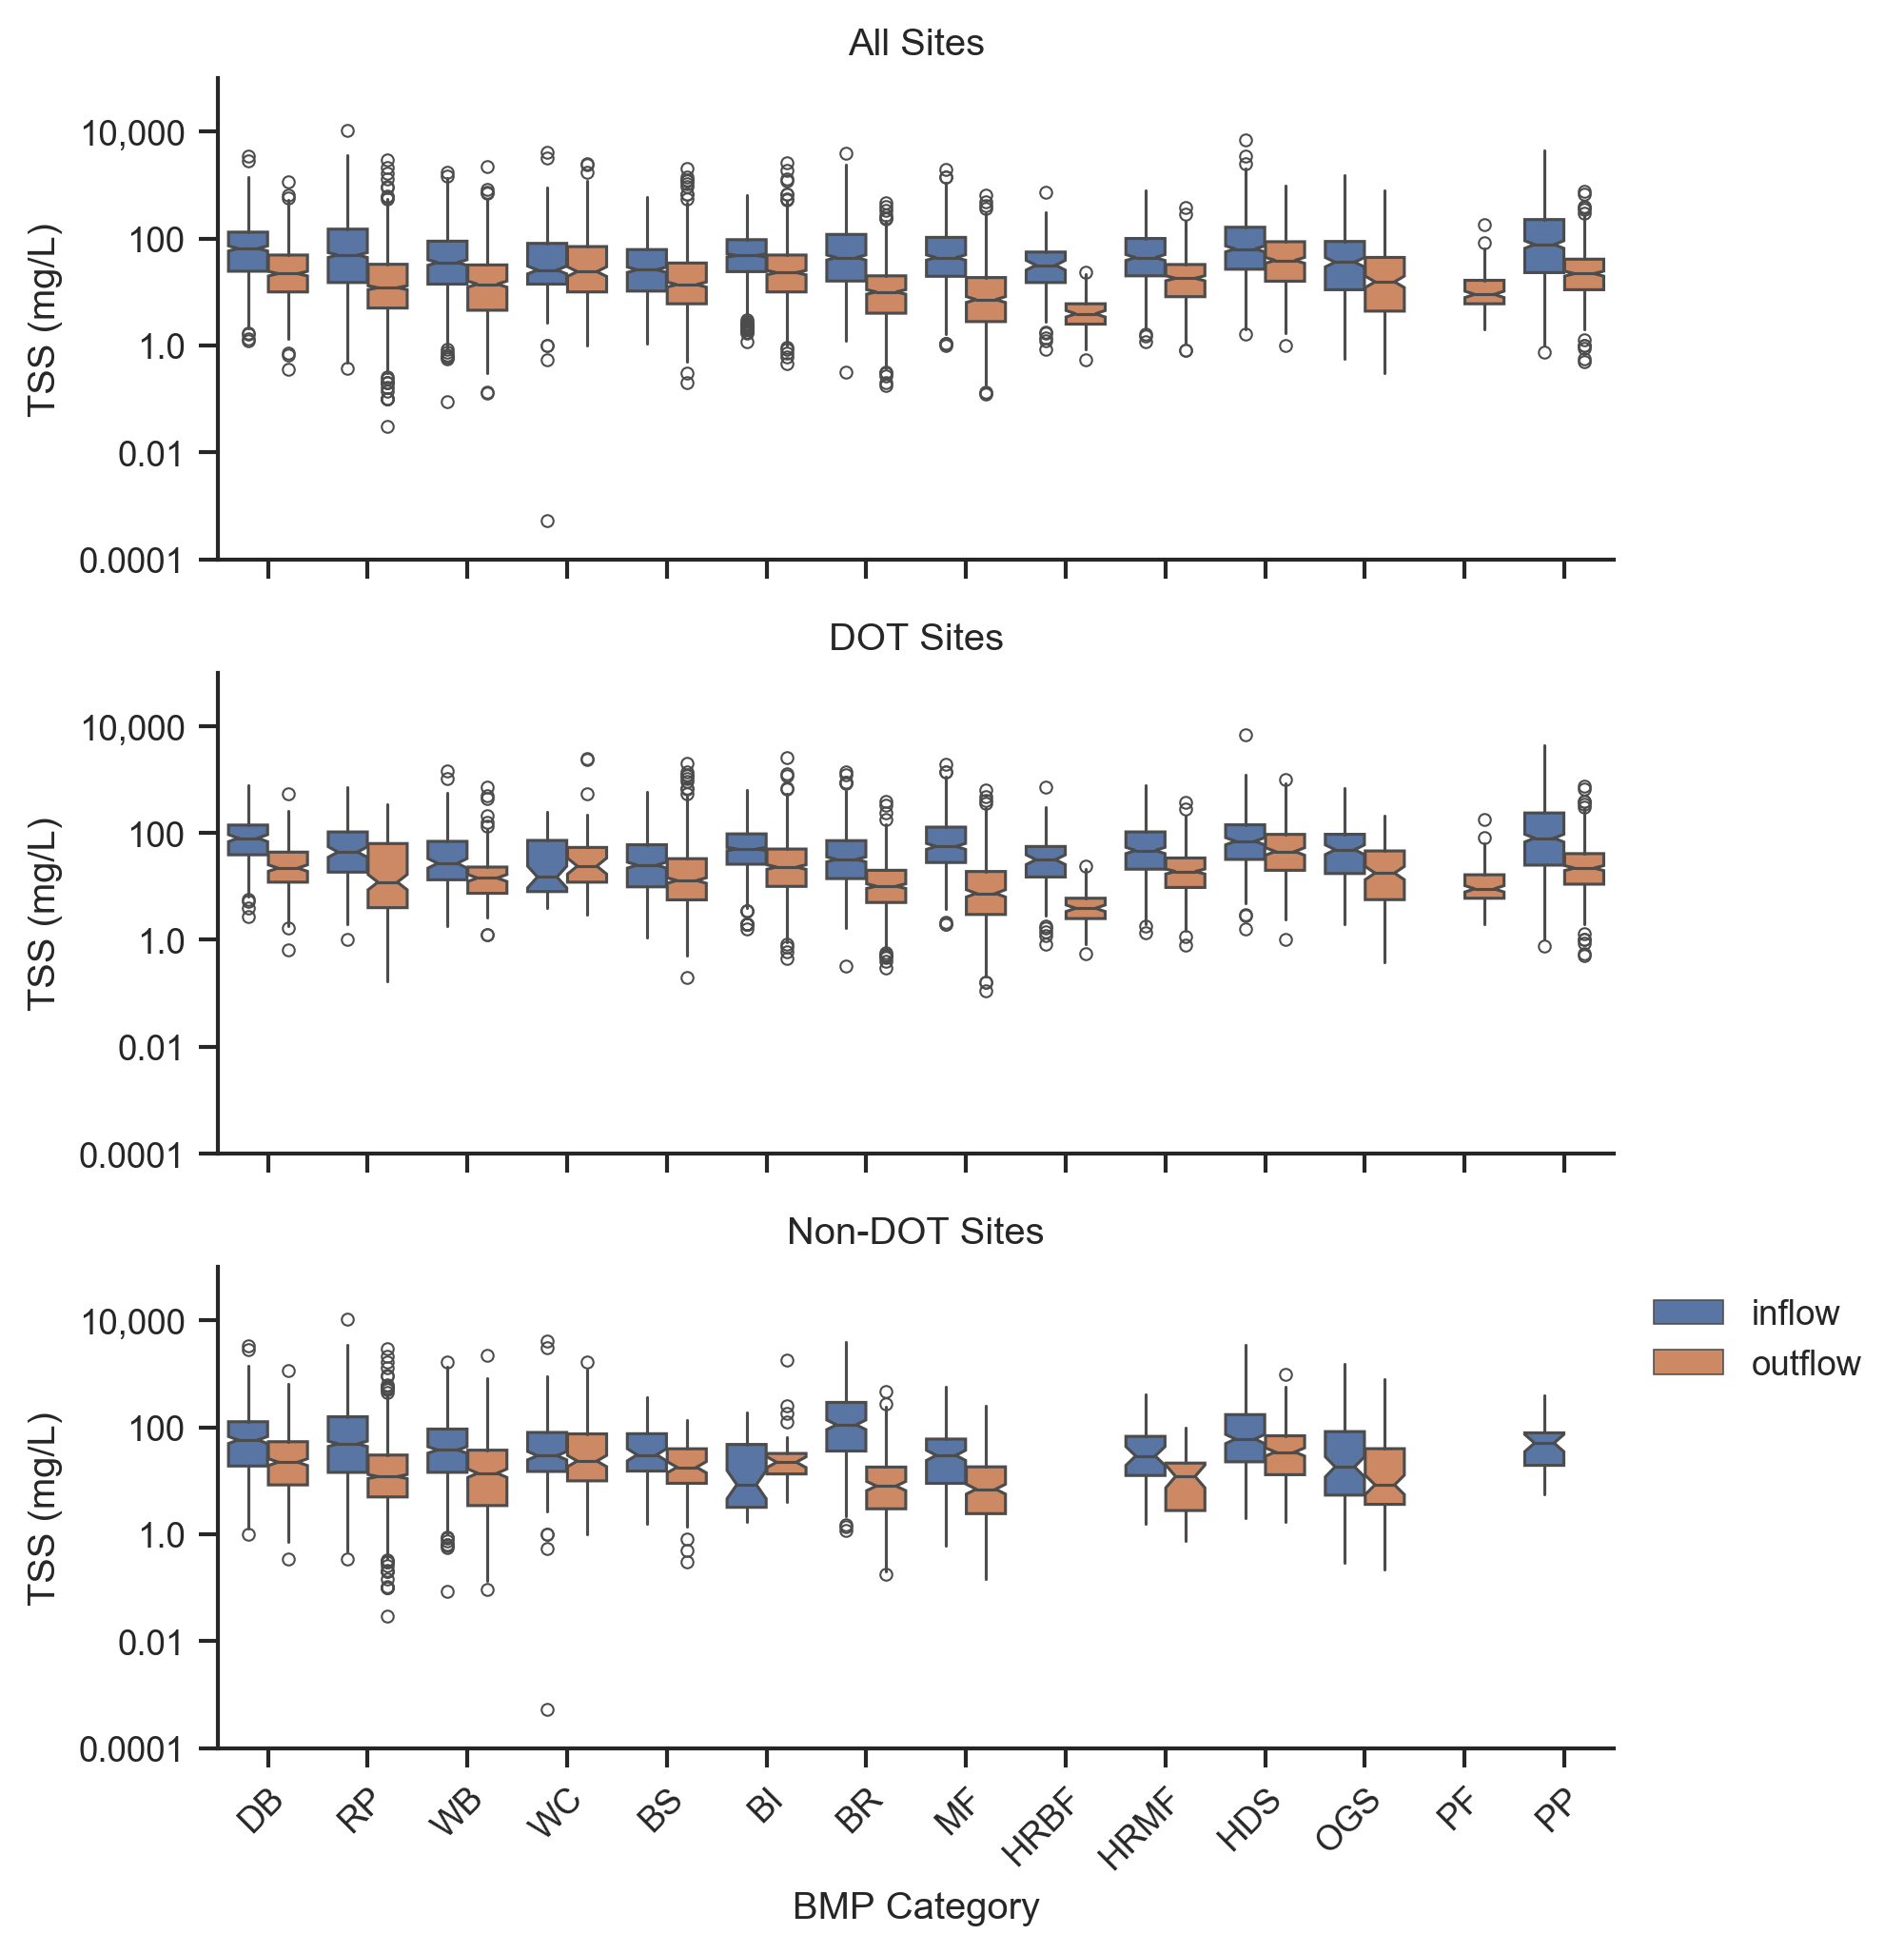
Data Analysis - TSS
Median influent similar between DOT and non-DOT sites and generally ranges between 20 and 80 mg/L
All BMPs with enough data for analyses show statistically significant reductions
Best performers are bioretention, media filters, and high rate biofiltration with effluent concentrations ranging from 4 to 10 mg/L

Slide 27
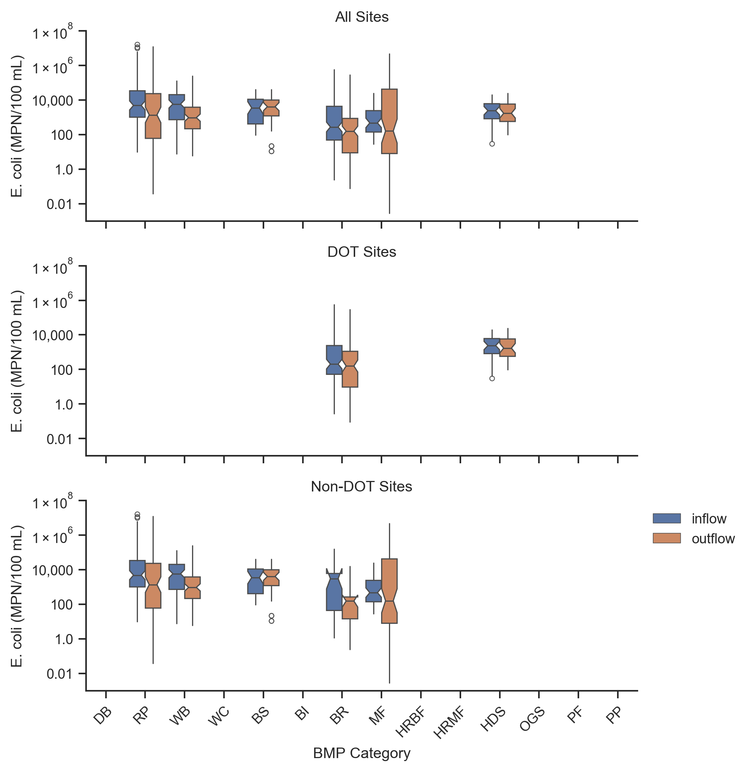
Data Analysis – E. coli
Insufficient data to distinguish between DOT and non-DOT sites
Retention ponds, wetland basins, bioretention, and media filters have statistically significant reductions
No BMP has demonstrated the ability to achieve median effluent concentrations below EPA’s recommended freshwater recreational water quality criteria for E. coli of 126 cfu/100mL

Slide 28
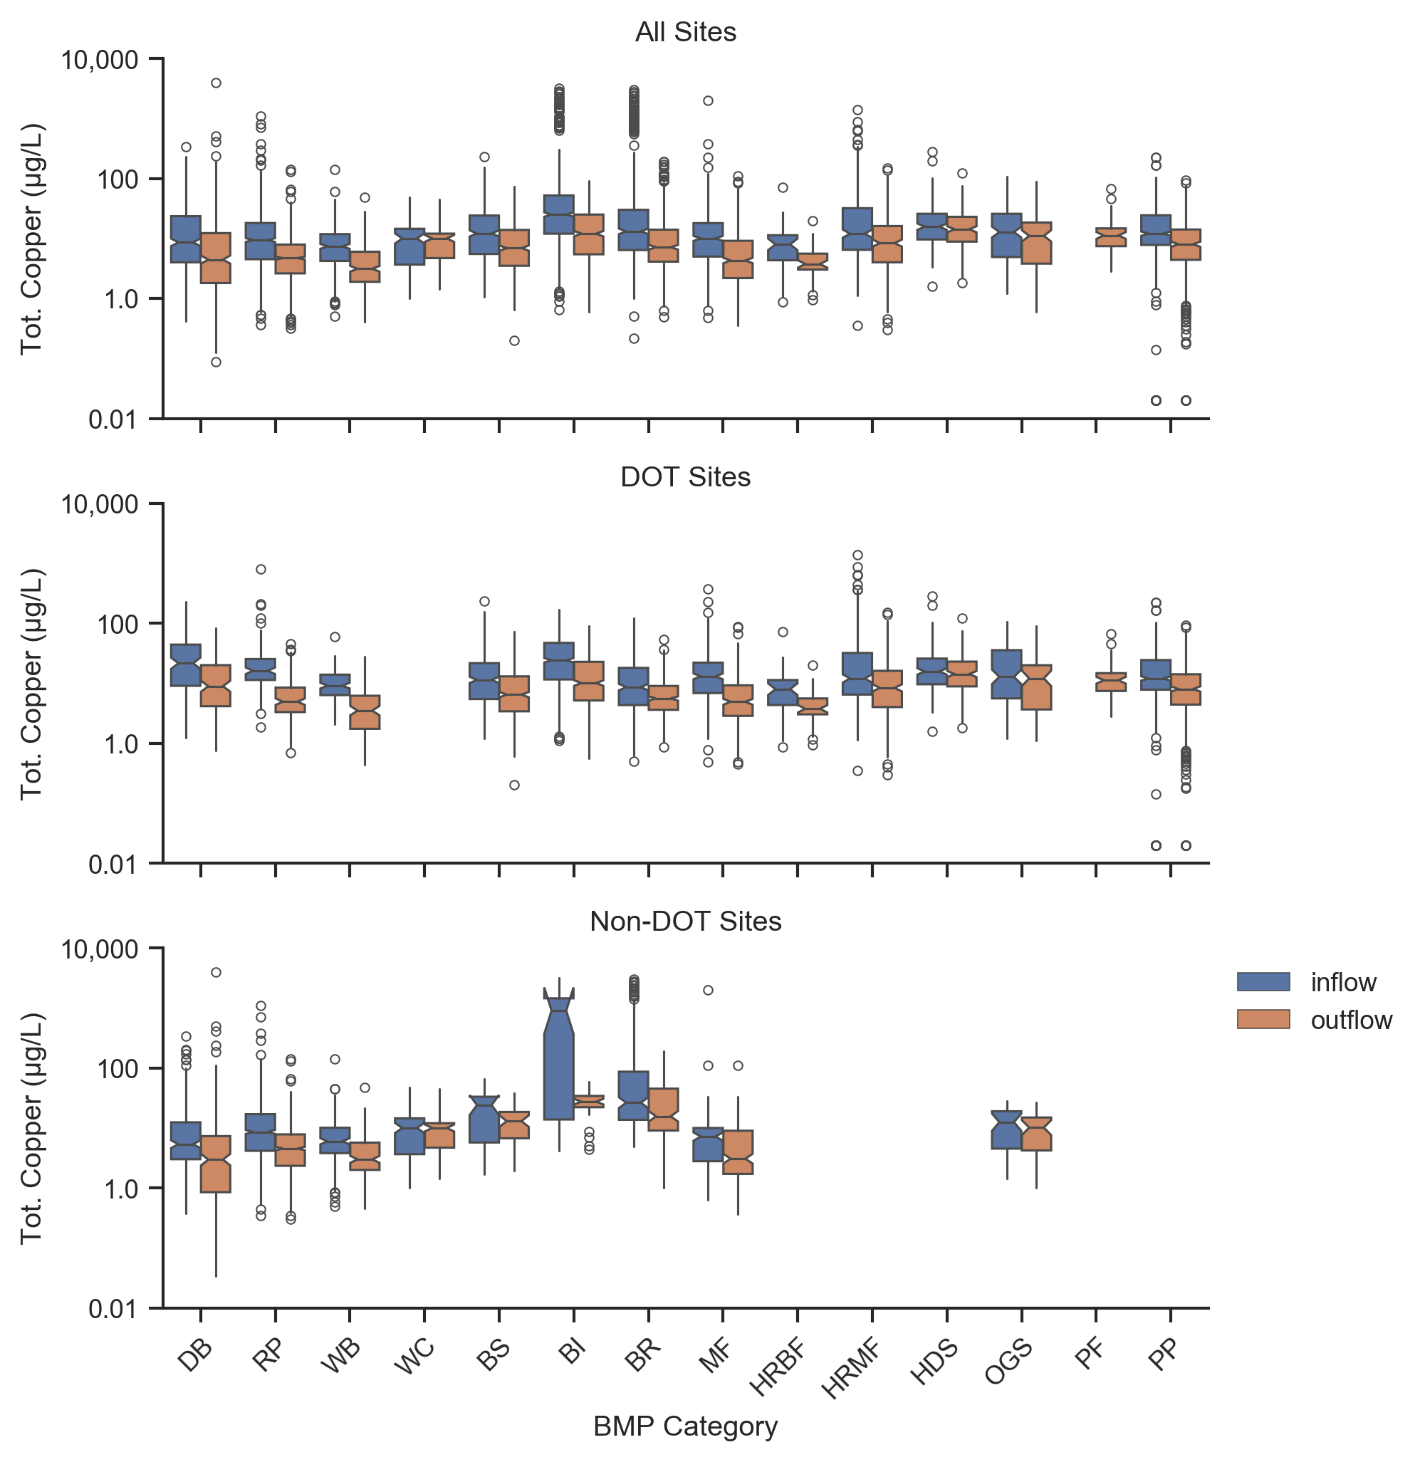
Data Analysis – Copper
Influent concentrations at DOT sites are often higher than non-DOT sites, but there are some high values for grass strips and bioretention for non-DOT sites*
Many BMP types show statistically significant reductions for both total and dissolved copper
Detention basins, retention ponds, wetland basins, media filters, and high rate biofiltration are top performers with median effluent ~5 µg/L
*There are two grass strip and two bioretention sites that receive runoff from a copper roof.

Slide 29
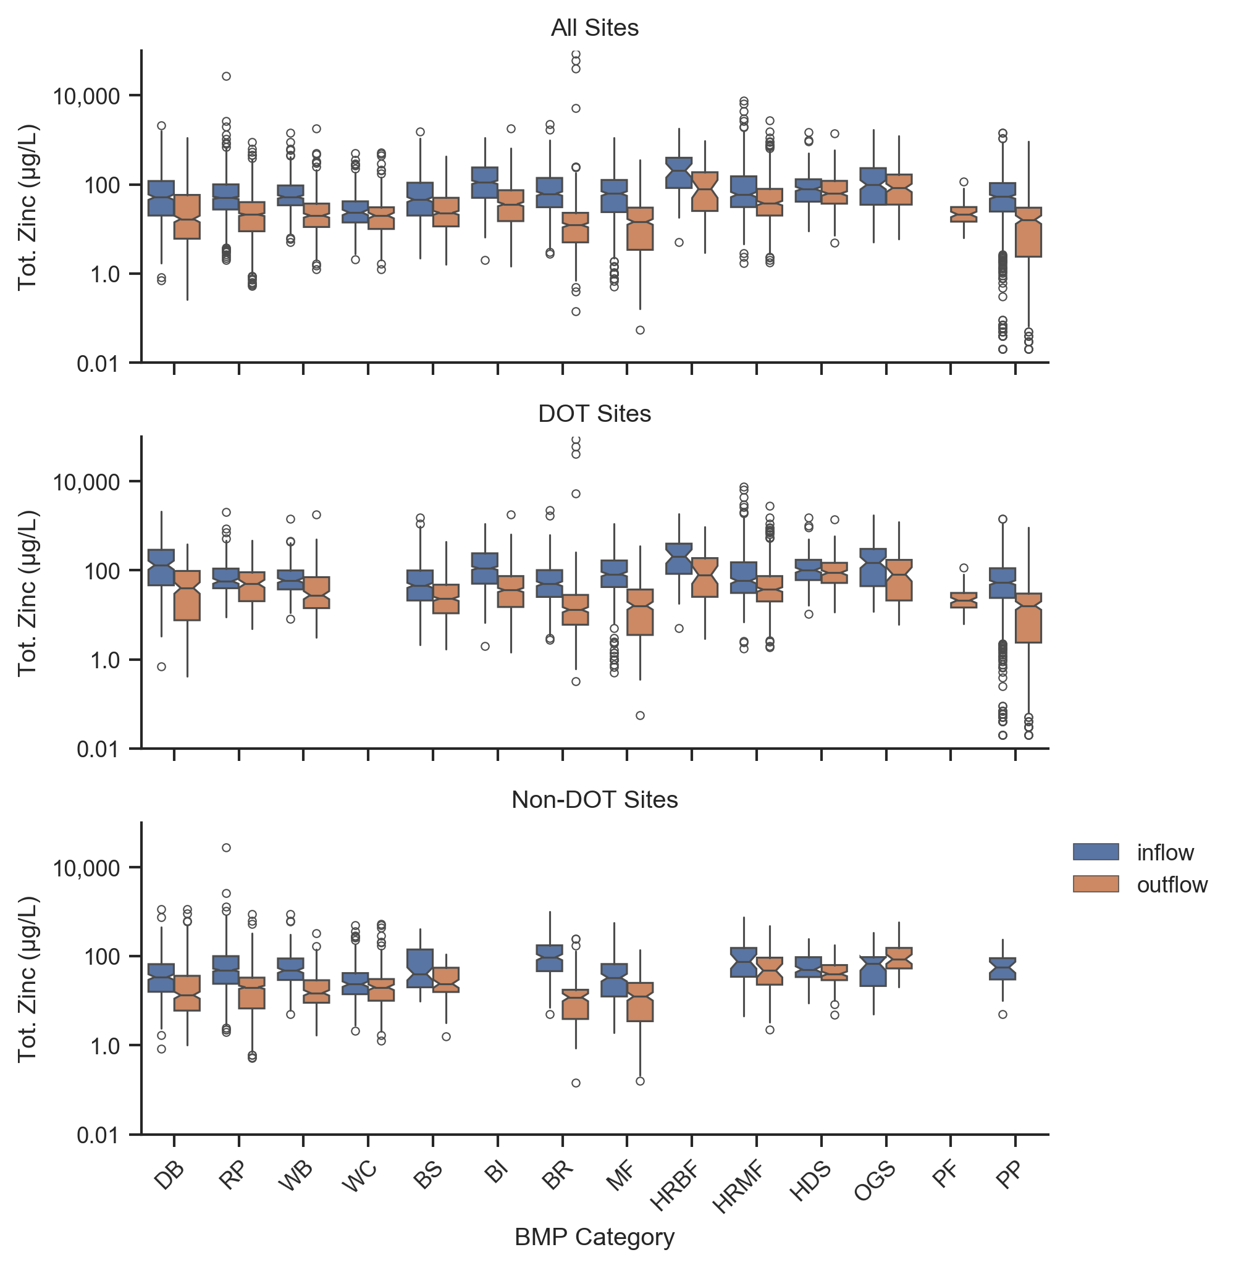
Data Analysis – Zinc
Influent concentrations at DOT sites are often higher than non-DOT sites, but not consistently
Many BMP types show statistically significant reductions for both total and dissolved zinc
Bioretention, media filters, and porous pavement are the top performers with total median effluent concentrations of 12 to 16 µg/L

Slide 30
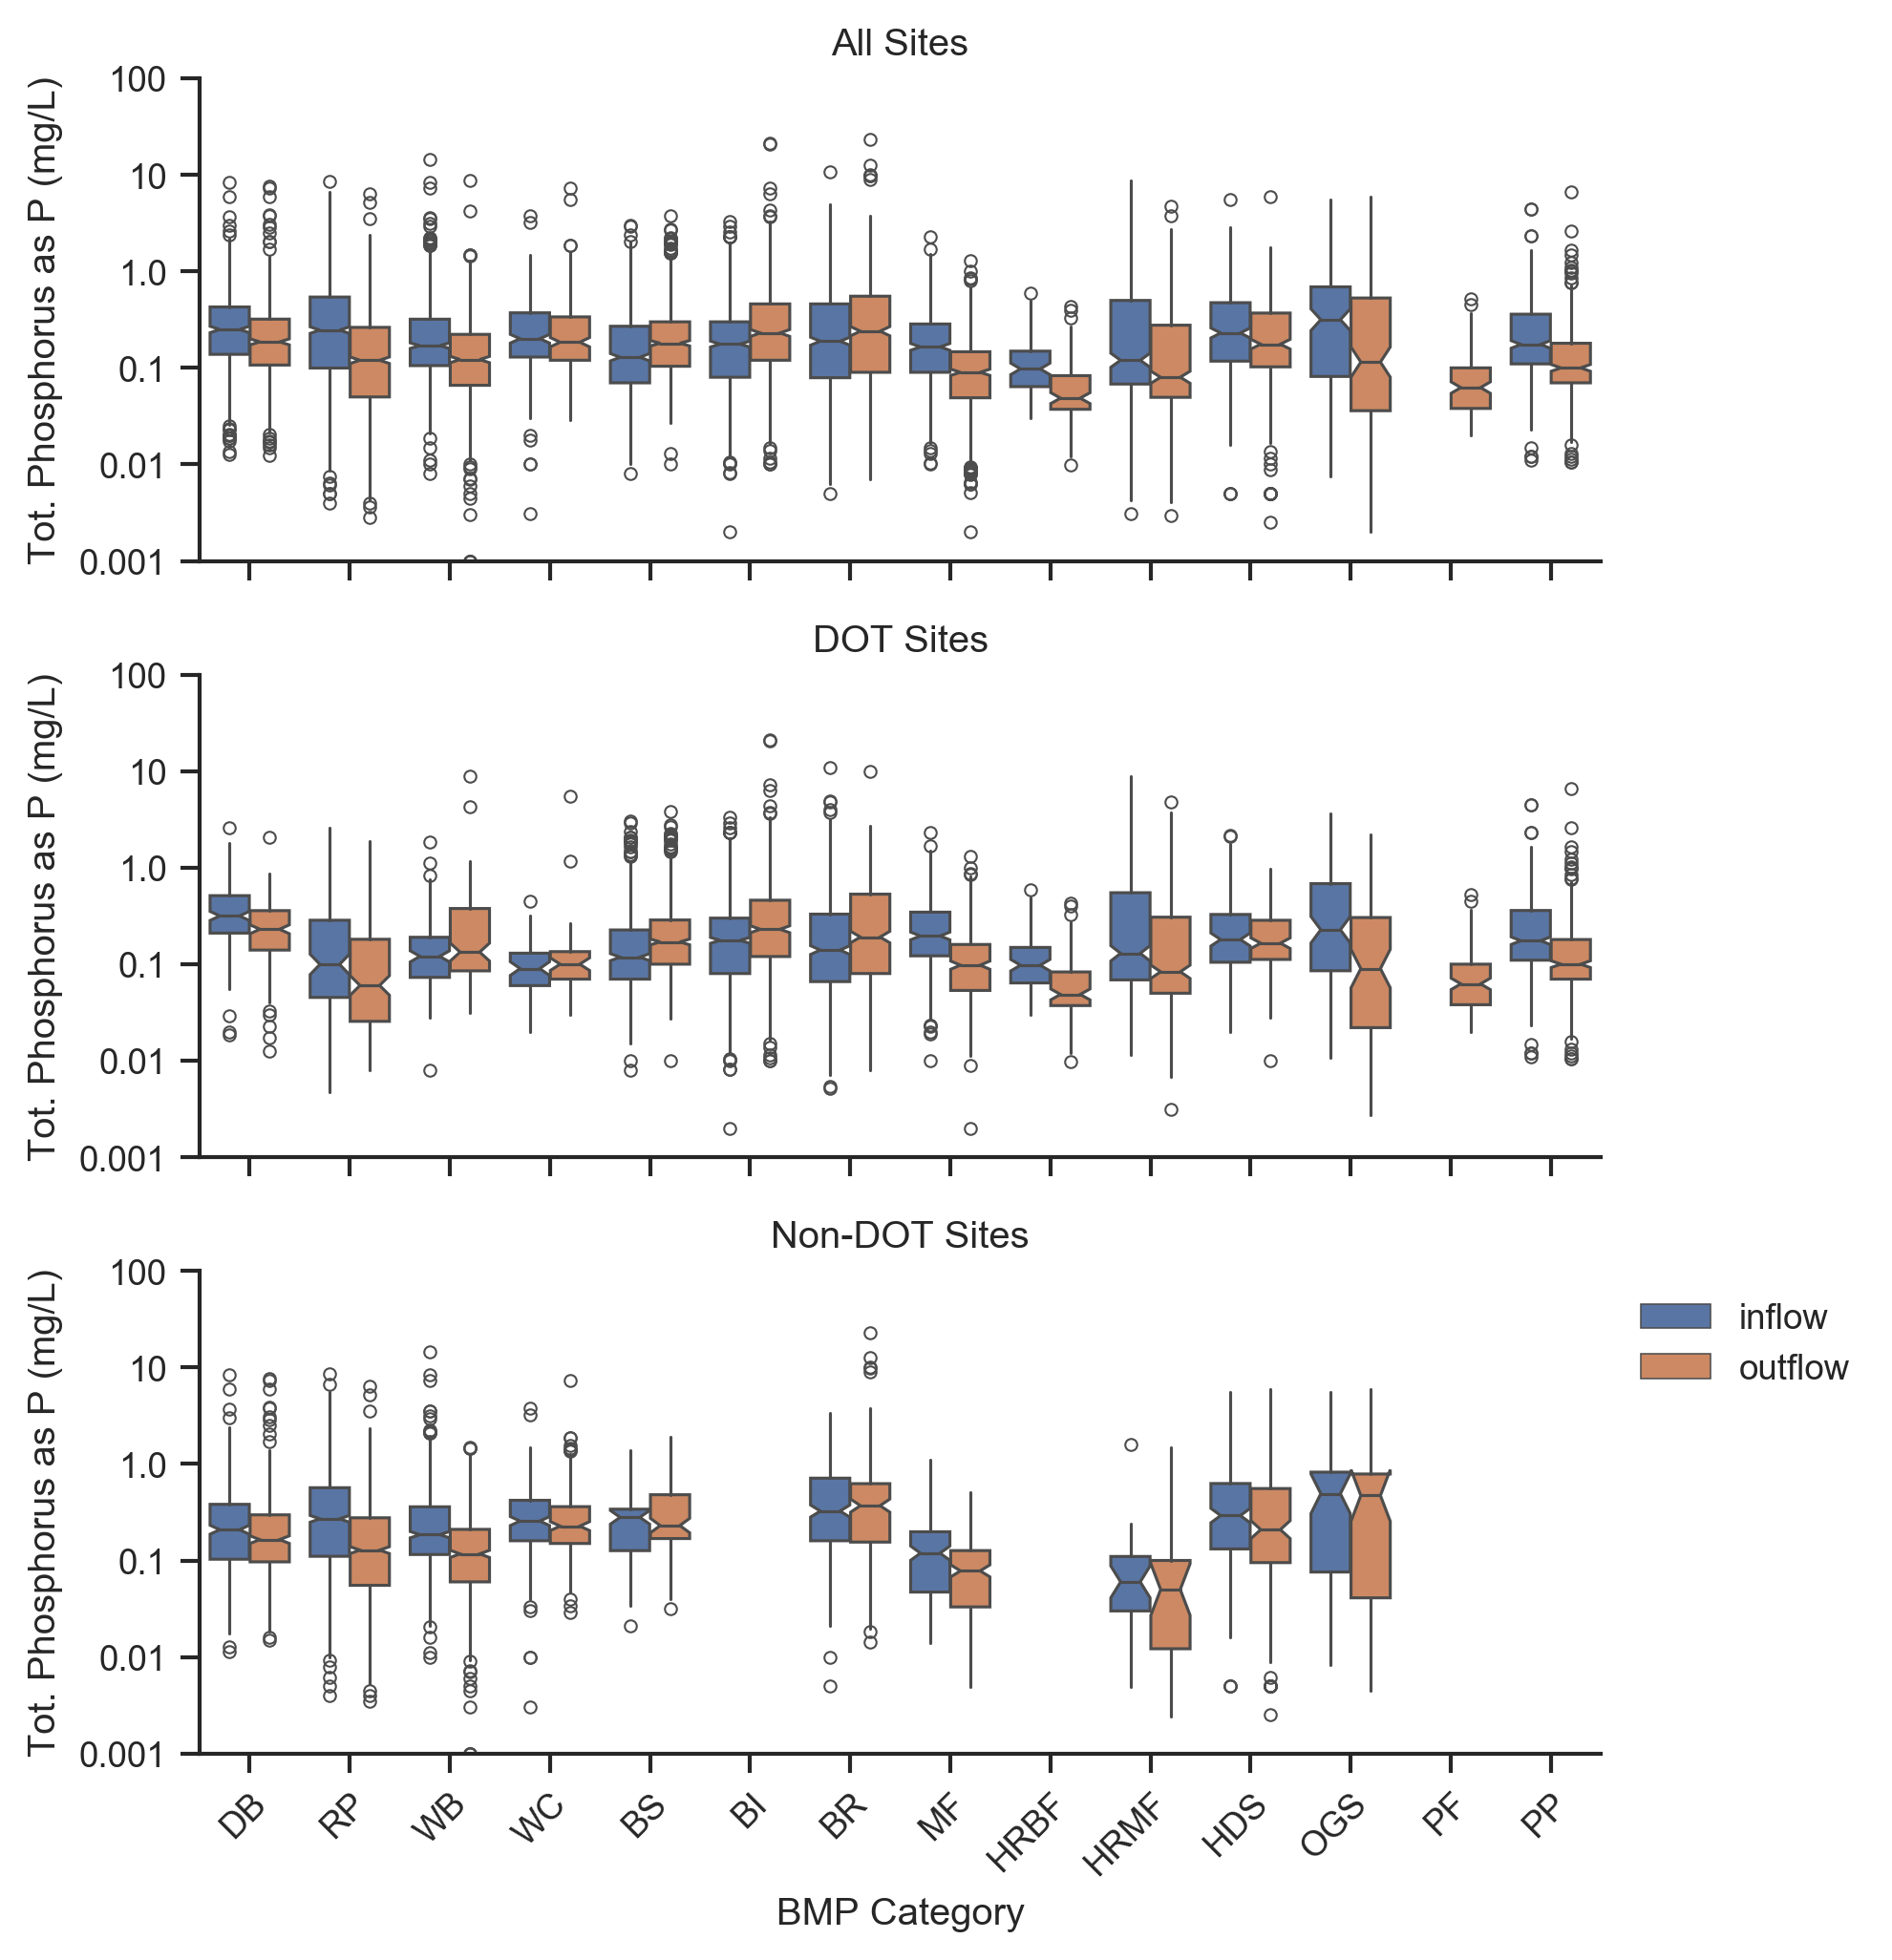
Data Analysis –Phosphorus
Median influent total phosphorous concentrations are similar between DOT and non-DOT sites, but both vary widely and generally range between 0.1 and 0.4 mg/L
Many BMPs show statistically significant reductions, but grass swales, grass strips, and bioretention show phosphorus export
Media filters, high rate biofiltration, and high rate media filtration are top performers with total phosphorus median effluent concentrations of 0.05 to 0.1 mg/L
Notes:
Note that while the influent phosphorus concentrations of DOT and non-DOT sites do not appear to be significantly different, it is important to note that non-DOT sites include a mixture of land uses. If these land uses were broken down further into commercial, residential, industrial, etc., there may be more distinguishable differences.

Slide 31
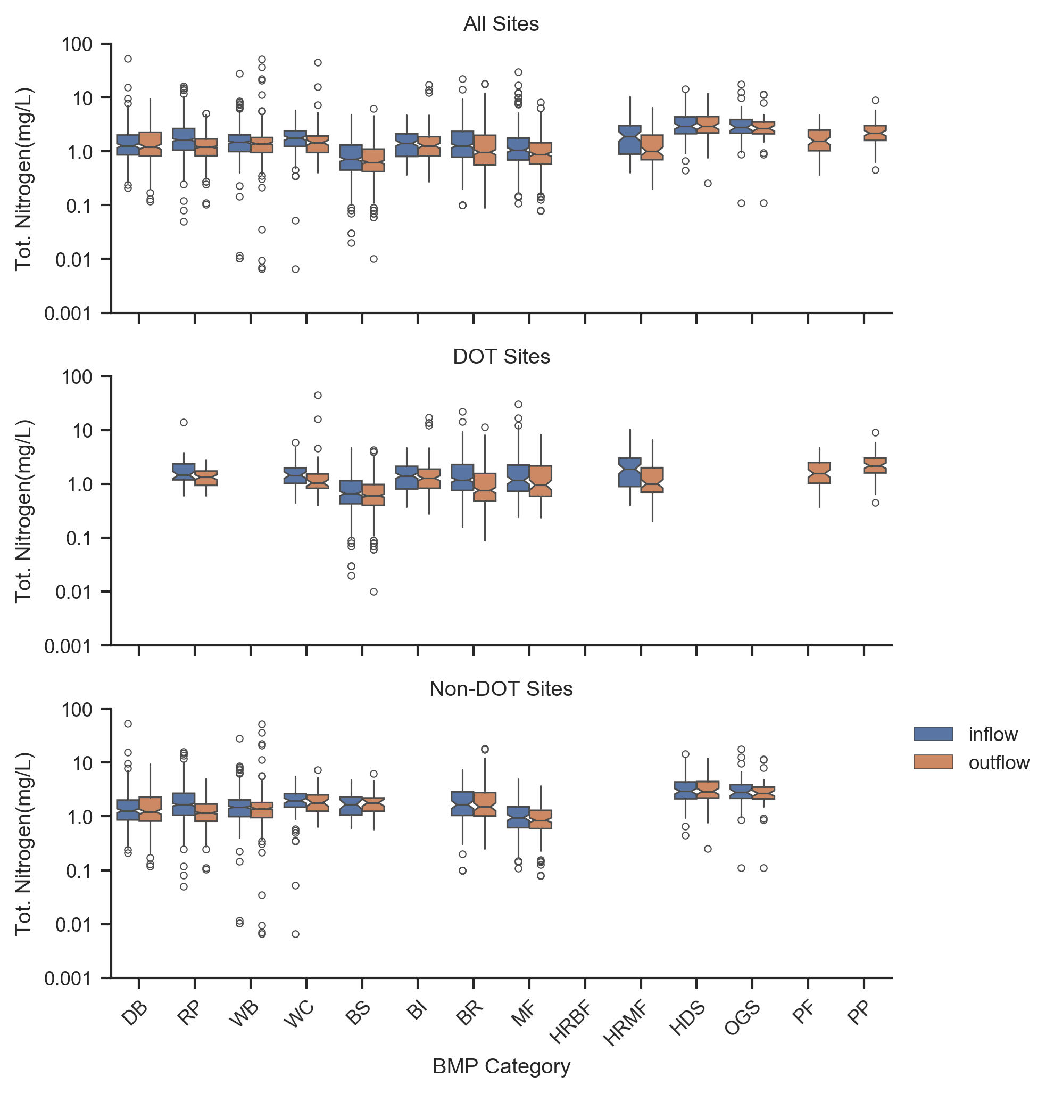
Data Analysis –Nitrogen
Median influent concentrations are similar between DOT and non-DOT sites
Media filters produce the lowest median effluent concentrations of 0.9 mg/L for total nitrogen and 0.5 mg/L for TKN
Bioretention, media filters, high rate media filters, and porous pavement show nitrate export indicating that ammonification and nitrification likely occurring

Slide 32
Summary and Conclusions
The DOT Portal to the BMP Database provides streamlined, online access to stormwater BMP monitoring data and performance statistics
The Portal can be used to assist DOTs with:
  BMP selection and implementation planning
  Regulatory discussions/negotiations
  Comparisons to site monitoring data and permit benchmarks/limits
  Development of stormwater management guidance and decision support tools
  And much more…
As data gaps are filled and new features evolve (based on stakeholder feedback), additional utility for the BMPDB and Portal will be realized
The continued support of the BMPDB project by the Water Research Foundation and its funding partners, such as the FHWA, will help ensure the Portal is maintained and available as a resource to transportation agencies

Slide 33
Data Gaps and Needs
Additional DOT-related BMP studies!
  Only 13 state DOTs are currently represented in the BMPDB
  Only 4 have more than 10 studies
Study sites especially needed in the Midwest, Southwest, Northern Plains, and Rocky Mountain states
AADT and other relevant metadata
  Of the 150 highway and urban roadway sites, only 47 (31%) have reported AADT data (might be able to be back-filled with additional effort in the future)
  Watershed and other land use information is lacking in many studies
Sparse data sets for:
  Fecal indicator bacteria
  Heavy metals other than copper, lead, and zinc
  Organic pollutants, such as TPH, PAHs, PCBs, phthalates, and dioxins
Additional media filter and biofiltration studies with more engineered media mixes (e.g., peat, biochars, oxide-coated sands, etc.)
Additional porous pavement and permeable friction course studies

Slide 34
Conduct More Studies!
Contribute Data!
Use the Database!
Calling All Stormwater BMP Researchers!!

Slide 35
Questions?
Marc Leisenring
Geosyntec Consultants, Inc.
mleisenring@Geosyntec.com
Paul Hobson
Geosyntec Consultants, Inc.
phobson@Geosyntec.com
Jane Clary
Wright Water Engineers, Inc.
clary@wrightwater.com

Slide 36
Acknowledgments
Study was conducted for:
The AASHTO Committee on Environment and Sustainability with funding provided through the National Cooperative Highway Research Program (NCHRP) Project 25-25, Task 120, Use of the State Department of Transportation Portal to the International Stormwater BMP Database. https://apps.trb.org/cmsfeed/TRBNetProjectDisplay.asp?ProjectID=4694
Project was managed by:
Ann Hartell, Senior Program Officer, NCHRP
Work was guided by a technical work group:
William Fletcher, Chair, Oregon DOT (retired)
Fred Noble, Florida DOT
Greg Granato, U.S. Geological Survey
Melissa Scheperle, Missouri DOT
Brandon Slone, Washington State DOT
Scott Crafton, Virginia DOT
Scott McGowen, Michael Baker International
Agency liaisons include:
Susan Jones, Federal Highway Administration
Melissa Savage, American Association of State Highway and Transportation Officials

